Slide 1
Coordination and Component Composition
Farhad Arbab
Center for Mathematics and Computer Science (CWI), Amsterdam
Leiden Institute of Advanced Computer Science, Leiden University
March 2015

Slide 2
Software Engineering
Applying engineering discipline to construction of complex software intensive systems.
A hallmark of all engineering disciplines is composition:
  Construct more complex systems by composing simpler ones.
  Derive properties of composed system as a composition of the properties of its constituents.

Slide 3
Models of Concurrency
Traditional models are action based
  Petri nets
  Work flow / Data flow
  Process algebra / calculi
  Actor models / Agents
  …
In prominent models, a system is composed from building blocks that represent actions/processes
Interaction becomes an implicit side-effect
  Makes coordination of interaction more difficult to
    Specify
    Verify
    Manipulate
    Reuse

Slide 4
Process Algebraic Model
Shared entities
Consumer
Producers
Model
What are the primitives and constructs in this model?
  Shared names to synchronize communication:
    g, r, b, d
  Atomic actions:
    Primitive actions defined by algebra:
      ?_(_), !_(_)
    User-defined actions:
      genG(_), genR(_), print(_)
  Composition operators:
    ., |, +, :=, implied recursion
A model is constructed by composing (atomic) actions into (more complex) actions.
Primarily a model of actions/processes
  Hence the name “process algebra”
Where is interaction?
synchronization-points: g, r, b, d
B := ?b(t) . print(t) . !d("done") . B
G := ?g(k) . genG(t) . !b(t) . ?d(j) . !r(k) . G
R := ?r(k) . genR(t) . !b(t) . ?d(j) . !g(k) . R
G | R | B | !g("token")

Slide 5
Implicit Interaction
Interaction (protocol) is implicit in action-based models of concurrency
Interaction is a by-product of processes executing their actions
  Action ai of process A collides with action bj of process B
  Interaction is the specific (timed) sequence of such collisions in a run
  Interaction protocol is the (timed) sequence of the intended collisions in such a sequence.
How can the intended and the coincidental be differentiated?
How can the sequence of intended collisions (the interaction protocol) can be
  Manipulated?
  Verified?
  Debugged?
  Reused ?
  ...
a2,b5
c3, d1
b3, d8
a2,b5
a1,e7
a2,b6
a2,b5
d2,e3
d7,b8
a3, d4
d2,b5
c7,e6
a6, d5
a6,e5
d1,e2
Possible only indirectly, through manipulating processes

Slide 6
Component behavior
α =
93
, 64
, “abc”
, …
, 3
, “Lumis”
, 23
, 685.92
, …
, 1.31
, 1.67
, 3.72
a =
1.3
, 1.85
, 2.69
, 8.74
C
β =
, 48
, …
34
, “gtk”
, 1132.8
, 36
, “Hello!”
(γ,c)
, 5
, …
, 1.45
, 1.67
, 2.01
, 5.62
, 12.9
b =
1.2
, 2.69
(ε,e)
(δ,d)
Timed-data-streams (TDS): (α, a), (β, b), (γ, c), (δ, d), (ε, e)
Abstract Behavior Type (ABT): Relation over TDSs:
C = ((α, a), (γ, c); (β, b), (δ, d), (ε, e))
F. Arbab "Abstract Behavior Types: A foundation model for components and their composition," International Symposium on Formal Methods for Components and Objects, (FMCO 2002), November 5-8, 2002, Leiden, The Netherlands, F. S. de Boer and M. M. Bonsangue and S. Graf and W.-P. de Roever (eds.), LNCS 2852, pp. 33-70, September 2003.
F. Arbab and J.J.M.M. Rutten, "A coinductive calculus of component connectors," post Proc. of the 16th International Workshop on Algebraic Development Techniques (WADT 2002), M. Wirsing, D. Pattinson and R. Hennicker (eds.), LNCS 2755, pp. 35-56, 2003.
J.J.M.M. Rutten, “Component Connectors,” In Prakash Panangaden and Franck van Breugel, editors, Mathematical Techniques for Analyzing Concurrent and Probabilistic Systems, volume 23 of CRM, pages 73-87, AMS, 2004.

Slide 7
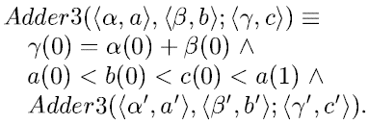
Component examples
Synchronously passes its input as its output:
  Sync((α, a); (β, b)) ≡ α = β, a = b
An infinite FIFO:
  FIFO((α, a); (β, b)) ≡ α = β, a < b
A FIFO1:
  FIFO((α, a); (β, b)) ≡ α = β, a < b < a’
An adder:
(α,a)
Sync
(β,b)
(α,a)
FIFO
(β,b)
(α,a)
FIFO1
(β,b)
(α,a)
Adder3
(χ,c)
(β,b)

Slide 8
Composition of components
Composition of active components yields concurrent systems.
What makes concurrency difficult is interaction.
Traditional models of concurrency are action-based.
  Concurrency protocols expressed as by-products of actions.
Reo offers an interaction-based model of concurrency.
  The only first-class concept is interaction.
F. Arbab "Coordination of Mobile Components," International Workshop on Concurrency and Coordination (ConCoord), Lipari, Italy, 6-8 July 2001, Electronic Notes in Theoretical Computer Science, Vol. 54, pp. 1-16, Elsevier Science, 2001.
F. Arbab and F. Mavaddat, "Coordination Through Channel Composition," Coordination Languages and Models: Proc. Coordination 2002, York, UK, April 2002, LNCS 2315, pp.21-38.
F. Arbab, "Reo: A Channel-based Coordination Model for Component Composition," Mathematical Structures in Computer Science, Cambridge University Press, Vol. 14, Issue 3, pp. 329-366, June 2004.
F. Arbab "Puff, The Magic Protocol," Formal Modeling: Actors, Open Systems, Biological Systems 2011, SRI International, Menlo Park, California, November 3-4, 2011, Lecture Notes in Computer Science, Springer, vol. 7000, pp. 169-206.
S-S.T.Q. Jongmans and F. Arbab, "Overview of Thirty Semantic Formalisms for Reo," Scientific Annals of Computer Science, v 12, Issue 1, pp. 201-251, 2012.

Slide 9
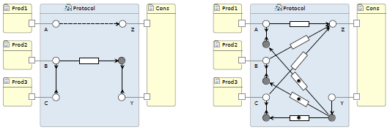
Reo
Reo is a language for compositional construction of interaction protocols.
Interaction is the only first-class concept in Reo:
  Explicit constructs representing interaction
  Composition operators over interaction constructs
Protocols manifest as a connectors
In its graphical syntax, connectors are graphs
  Data items flow through channels represented as edges
  Boundary nodes permit (components to perform) I/O operations
Formal semantics given as ABT (and various other formalisms)
Tool support: draw, animate, verify, compile

Slide 10
Channels
Atomic connectors in Reo are called channels.
Reo generalizes the common notion of channel.
A channel is an abstract communication medium with:
  exactly two ends; and
  a constraint that relates (the flows of data at) its ends.
Two types of channel ends
  Source: data enters into the channel.
  Sink: data leaves the channel.
A channel can have two sources or two sinks.
A channel represents a primitive interaction.

Slide 11


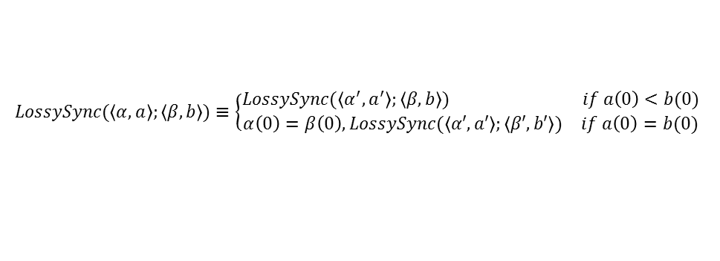



Channels: binary components
Synchronously passes its input as its output:
An infinite FIFO:
A FIFO1:
A lossy synchronous channel:
A Synchronous drain:
A Synchronous spout:
Sync($\left\langle α,a\right\rangle ;\left\langle β,b\right\rangle )≡α=β, a=b$
(α,a)
Sync
(β,b)
FIFO($\left\langle α,a\right\rangle ;\left\langle β,b\right\rangle )≡α=β, a<b$
(α,a)
FIFO
(β,b)
FIFO1($\left\langle α,a\right\rangle ;\left\langle β,b\right\rangle )≡α=β, a<b<a′$
(α,a)
FIFO1
(β,b)
$$LossySync(\left\langle α,a\right\rangle ;\left\langle β,b\right\rangle )≡\left\{\begin{aligned}\begin{matrix}LossySync(\left\langle α^{′},a^{′}\right\rangle ;\left\langle β,b\right\rangle ) & if a\left(0\right)<b(0)\end{matrix} \\ \begin{matrix}α\left(0\right)=β\left(0\right),LossySync(\left\langle α′,a′\right\rangle ;\left\langle β′,b′\right\rangle ) & if a\left(0\right)=b(0)\end{matrix}\end{aligned}\right.$$
(α,a)
LossySync
(β,b)
SyncDrain($\left\langle α,a\right\rangle ,\left\langle β,b\right\rangle ;)≡a=b$
(α,a)
SyncDrain
(β,b)
SyncSpout(;$\left\langle α,a\right\rangle ,\left\langle β,b\right\rangle )≡a=b$
(α,a)
SyncSpout
(β,b)

Slide 12
Join
Mixed node
  Merge + replication combo
Sink node
  Non-deterministic merge
Source node
  Replication
a
b
c
a
b
c
b
a
c

Slide 13

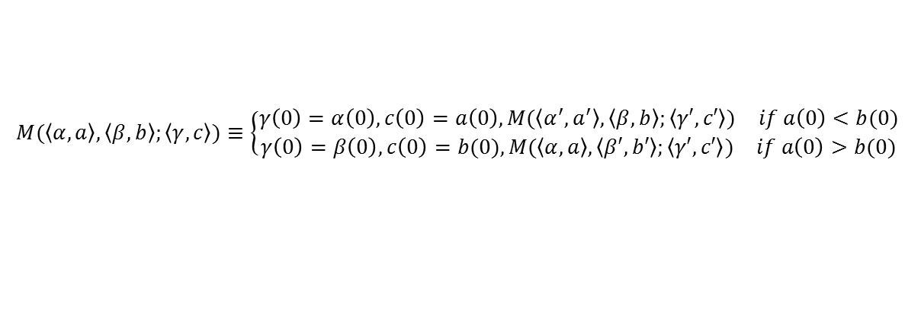
Behavior of Reo Nodes
Nondeterministic binary merge:
Binary replicator:
(α,a)
(χ,c)
(β,b)
$$M(\left\langle α,a\right\rangle ,\left\langle β,b\right\rangle ;\left\langle γ,c\right\rangle )≡\left\{\begin{aligned}\begin{matrix}γ\left(0\right)=α\left(0\right), c\left(0\right)=a\left(0\right),M(\left\langle α^{′},a^{′}\right\rangle ,\left\langle β,b\right\rangle ;\left\langle γ′,c′\right\rangle ) & if a\left(0\right)<b(0)\end{matrix} \\ \begin{matrix}γ\left(0\right)=β\left(0\right),c\left(0\right)=b(0),M(\left\langle α,a\right\rangle ,\left\langle β′,b′\right\rangle ;\left\langle γ′,c′\right\rangle ) & if a\left(0\right)>b(0)\end{matrix}\end{aligned}\right.$$
(β,b)
$R(\left\langle α,a\right\rangle ;\left\langle β,b\right\rangle ,\left\langle γ,c\right\rangle )≡$ $α$= $β$= $γ$, a=b=c
(α,α)
(χ,c)

Slide 14
Reo Connectors
FIFO1 channel
synchronous
channel
lossy synchronous
channel
filter channel
P-producer
≤τ
synchronous drain
asynchronous drain
synchronous spout
asynchronous spout
timer channel
B
B
A
=
A
C
C
Exclusive choice (deffered XOR)
A
B
Valve connector:
controls flow from A to B
open
close

Slide 15
A Simple Composed System
Read-cue synchronous flow-regulator
p
!x
?
c
x
t
?
x

Slide 16
Flow regulator
Write-cue synchronous flow-regulator
a
x
!x
?
c
!y
b

Slide 17
Take a through d when b or c
A take from d succeeds only if there is a value written to b or c.
The values taken from d are elements of the stream a*
We have d = ((b|c)/a)*
a
d
b
c

Slide 18
Flow Synchronization
The write/take operations on the pairs of channel ends a/c and b/d are synchronized.
Barrier synchronization.
!x
!x
!x
!x
?
?
?
a
c
x
!y
?
?
y
b
d

Slide 19
Alternator
Subsequent takes from c retrieve the elements of the stream (ab)*
Both a and b must be present before a pair can go through.
!1
!3
!1
!1
!3
!3
!3
!3
?
?
?
?
4,3,2,1
3,2,1
3,2,1
2,1
2,1
1
1
1
1
a
c
b
!4
!4
!4
!2
!4
!2
2
2
4
4
2
2

Slide 20
Alternator for n>2 Sources
As a step toward generalization, add a redundant Sync channel:
a
c
b

Slide 21
N-Alternator
Subsequent takes from z retrieve the elements of the stream (abcd)*
a
z
b
c
d

Slide 22
Alternating Producers
We can use the alternator circuit to impose the protocol on the green and red producers of our example
  From outside
  Without their knowledge

Slide 23
Sequencer
Writes to a, b, c, and d will succeed cyclically and in that order.
!3
!1
c
!4
!2
a
b
d
o
o
o
o

Slide 24
Sequenced Producers
A two-port sequencer and a few channels form the connector we need to compose and exogenously coordinate the green/red producers/consumer system.
Sequencer

Slide 25
Overflow Lossy FIFO1
A FIFO1 channel that accepts but loses new incoming values if its buffer is full.

Slide 26
Exclusive Router
A value written to a flows through to either b or c, but never to both.
a
=
b
c

Slide 27
Inclusive Router
A value written to a flows through to either b or c, or to both.
a
a
XRouter
b
c
b
c

Slide 28
Shift Lossy FIFO1
A FIFO1 channel that loses its old buffer contents, if necessary, to make room for new incoming values.
o

Slide 29
Sampled Producers
Adding variables to the sequencer solution, buffers the actions of the producers and the consumer.
Sequencer

Slide 30
Variable
Every input value is remembered and repeatedly reproduced as output, zero or more times, until it is replaced by the next input value.

Slide 31
Buffered Producers
Adding variables to the sequencer solution, buffers the actions of the producers and the consumer.
Sequencer

Slide 32
Dining Philosophers (problem)

Slide 33
Dining Philosophers (solution)

Slide 34
Fork
The fork component used in the dining philosophers problem is a pure coordinator and can be constructed as a Reo connector circuit.
f
t

Slide 35
Philosopher
Internal coordination of Think and Eat functions in a Philosopher.
0
Think
EAT

Slide 36
Concurrency in Reo
Reo embodies a non-conventional model of concurrency:
Reo is more expressive than Petri nets, workflow, and dataflow models.
Conventional
  action based
  process as primitive
  imperative
  functional
  imperative programming
  protocol implicit in processes
Reo
  interaction based
  Protocol as primitive
  declarative
  relational
  constraint programming
  Tangible explicit protocols

Slide 37
Semantics
Reo allows:
  Arbitrary user-defined channels as primitives.
  Arbitrary mix of synchrony and asynchrony.
  Relational constraints between input and output.
Reo is more expressive than, e.g., dataflow models, Kahn networks, workflow models, stream processing models, Petri nets, and synchronous languages.
Formal semantics:
  Coalgebraic semantics based on timed-data streams.
  Constraint automata.
  SOS semantics (in Maude).
  Constraint propagation (connector coloring scheme).
  Intuitionistic linear logic
Sung-Shik T.Q. Jongmans and Farhad Arbab, "Overview of Thirty Semantic Formalisms for Reo," Scientific Annals of Computer Science, vol. 12, Issue 1, pp. 201-251, 2012.

Slide 38
Fibonacci Series
This circuit produces the Fibonacci series using a an adder component.
The timed-data-streams semantics allows us to prove its correctness.
0
SUM
1

Slide 39
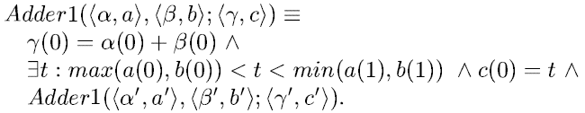
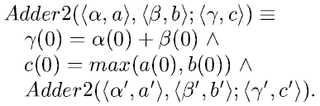
Some possible adders (1)
Arbitrary input order; produces an output after each pair of input, some time before the next input.
Arbitrary input order; produces an output at the same time as the last of each input pair.
Ordered input; produces an output after each pair of input, some time before the next input.

Slide 40
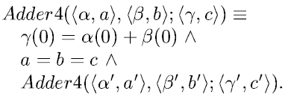
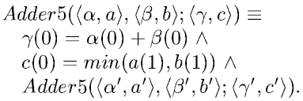
Some possible adders (2)
Synchronous adder: reads a pair and outputs their sum all at the same time (atomically).
Arbitrary input order; produces an output at the same time as the first of the next input pair.

Slide 41
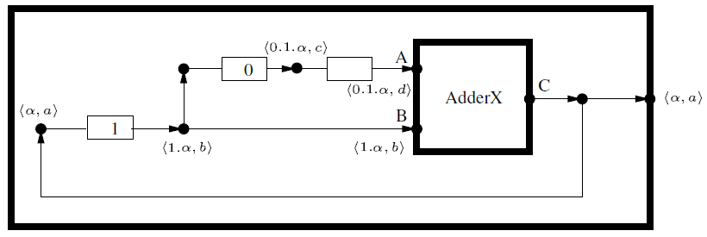
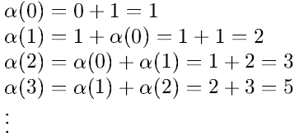
Fibonacci correctness proof (1)
d<b<a<d’
d<b
d’<b’
d<b<a<d’<b’
Real numbers c and c’ always exist to satisfy the timing equations.
Consistent!
Verified!

Slide 42
Fibonacci correctness proof (2)
d=b=a
The timing equations b=a and b<a have no solution!
No behavior!

Slide 43
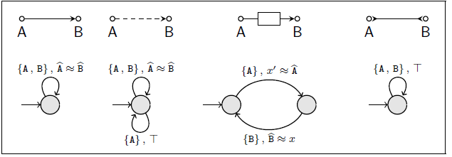
Constraint automata
Finite-state automata where a transition has a pair of constraints as its label:
  (Synchronization-constraint, Data-constraint)
Introduced to capture operational semantics of Reo
CA of typical Reo primitives:
F. Arbab, C. Baier, J.J.M.M. Rutten, and M. Sirjani, "Modeling Component Connectors in Reo by Constraint Automata," Proc. International Workshop on Foundations of Coordination Languages and Software Architectures (FOCLASA 2003), CONCUR 2003, Marseille, France, September 2003, Electronic Notes in Theoretical Computer Science, 97.22, Elsevier Science, July 2004.
C. Baier, M. Sirjani, F. Arbab, and J.J.M.M. Rutten, "Modeling Component Connectors in Reo by Constraint Automata," Science of Computer Programming, Elsevier, Vol. 61, Issue 2, pp. 75-113, July 2006.
F. Arbab, C. Baier, F.S. de Boer, and J.J.M.M. Rutten, "Models and Temporal Logical Specifications for Timed Component Connectors," International Journal on Software and Systems Modeling, pp. 59-82, Vol. 6, No. 1, March 2007, Springer.

Slide 44
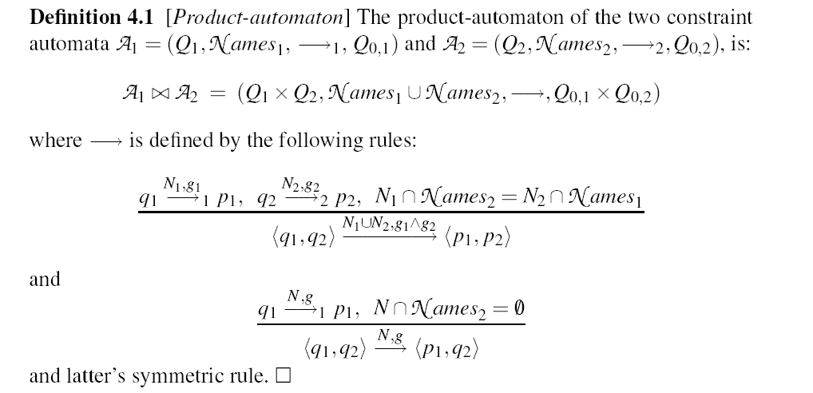
Product Constraint Automata

Slide 45
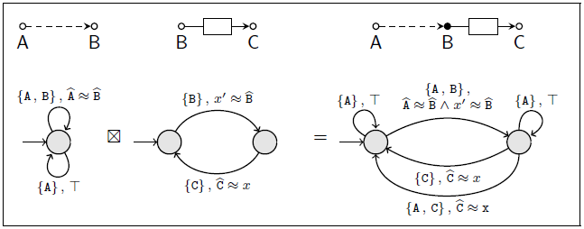
CA of a connector
The CA semantics of a connector is composed from the CA of its constituents via a synchronous product operator.

Slide 46
Eclipse Coordination Tools
A set of Eclipse plug-ins provide the ECT visual programming environment.
Protocols can be designed by composing Reo circuits in a graphical editor.
The Reo circuit can be animated in ECT.
ECT can automatically generate the CA for a Reo circuit.
Model-checkers integrated in ECT can be used to verify the correctness properties of a protocol using its CA.
ECT can generate executable (Java/C) code from a CA as a single sequential thread.
http://reo.project.cwi.nl

Slide 47
Tool support
Tool | Description
Reo graphical editor | Drag and drop editing of Reo circuits
Reo animation plug-in | Flash animation of data-flow in Reo circuits
Extensible Automata editor and tools | Graphical editor and other automata tools
Reo to constraint automata converter | Conversion of Reo to Constraint Automata
Verification tools | Vereofy model checker (www.vereofy.de) mCRL model checking Bounded model checking of Timed Constraint Automata
Java code generation plug-in | State machine based coordinator code (Java, C, and CA interpreter for Tomcat servlets)
Distributed Reo middleware | Distributed Reo code generated in Scala (Actor-based Java)
(UML / BPMN / BPEL) GMT to Reo converter | Automatic translation of UML SD / BPMN / BPEL to Reo
Reo Services platform | Web service wrappers and Mash-ups
Markov chain generator | Compositional QoS model based on Reo Analysis using, e.g., probabilistic symbolic model checker Prism (http://www.prismmodelchecker.org)
Algebraic Graph Transformation | Dynamic reconfiguration of Reo circuits

Slide 48
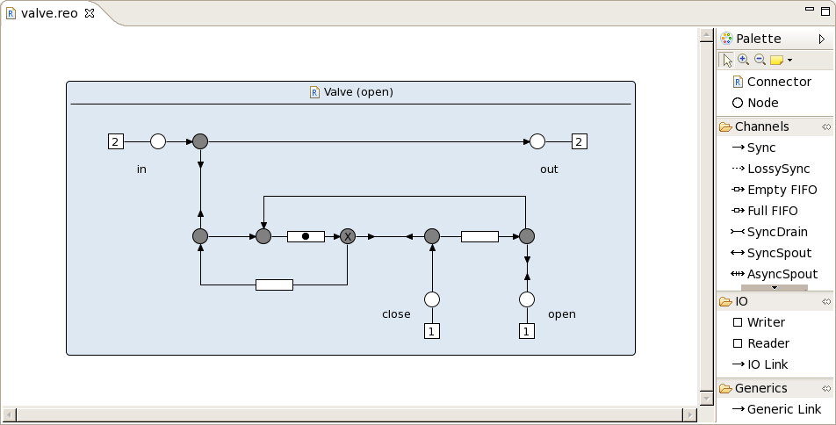
Snapshot of Reo Editor

Slide 49
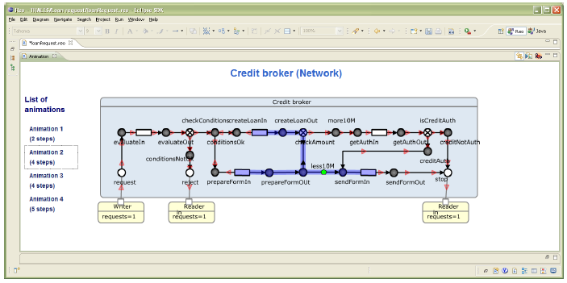
Reo Animation Tool

Slide 50
Model Checking
Constraint automata are used for model checking of Reo circuits
Model checker for Reo built in Dresden:
  Symbolic model, LTL, and CTL-like logic for specification
  Can also verify properties such as deadlock-freeness and behavioral equivalence
SAT-based bounded model checking of Timed Constraint Automata
Translation of Reo to mCRL for model checking

Slide 51
Vereofy Model Checker
Symbolic model checker for Reo:
  Based on constraint automata
  Developed at the University of Dresden
  LTL and CTL-like logic for property specification
Modal formulae
  Branching time temporal logic:
    AG[EX[true]]
    check for deadlocks
  Linear temporal logics:
    G(request → F (reject ∪ sendFormOut))
    check that admissible states reject or sendFormOut are reached
http://www.vereofy.de

Slide 52
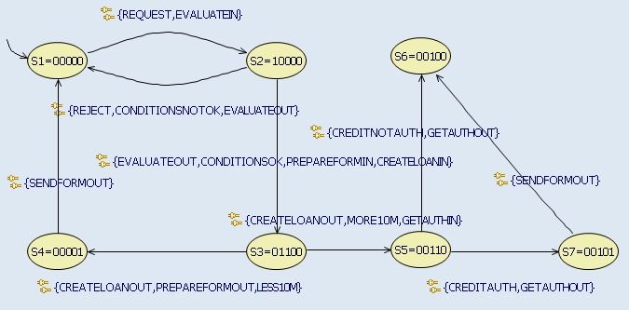
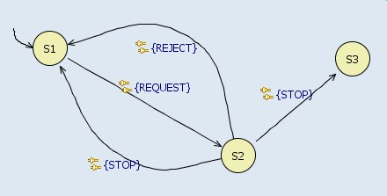
Verification with Vereofy
Reo2ConstraintAutomata
Modal formulae
  Branching time temporal logic: AG[EX[true]] – check for deadlocks
  Linear temporal logics: G(request → F (reject ∪ sendFormOut)) – check that admissible states reject or sendFormOut are reached

Slide 53
Data-Dependent Control-Flow
Input parameters:
  Activation condition
    Data: b: Boolean
    Filter condition: b==true, b==false
  Check condition
    Data: x, y: Real; (e.g., credit amount, maximal amount)
    Filter condition: x < y
Problems:
  Data constraint specification language is needed
  Properties that include conditions:
    G [(b & !(x < y)) → F violation]
Notes:
Replace fragment figure with the new figure from Stut.

Slide 54
Verification with mCRL2
  mCRL2 behavioral specification language and associated toolset developed at TU Eindhoven
  http://www.mcrl2.org
  Based on the Algebra of Communicating Processes (ACP)
  Extended with data and time
  Expressive property specification language (μ calculus)
  Abstract data types, functional language (λ calculus)
Automated mapping from Reo to mCRL2
  N. Kokash, E. d. V., C. Krause, Data-aware Design and Verification of Service Compositions with Reo and mCRL2, in: ACM Symposium on Applied Computing, 2010

Slide 55
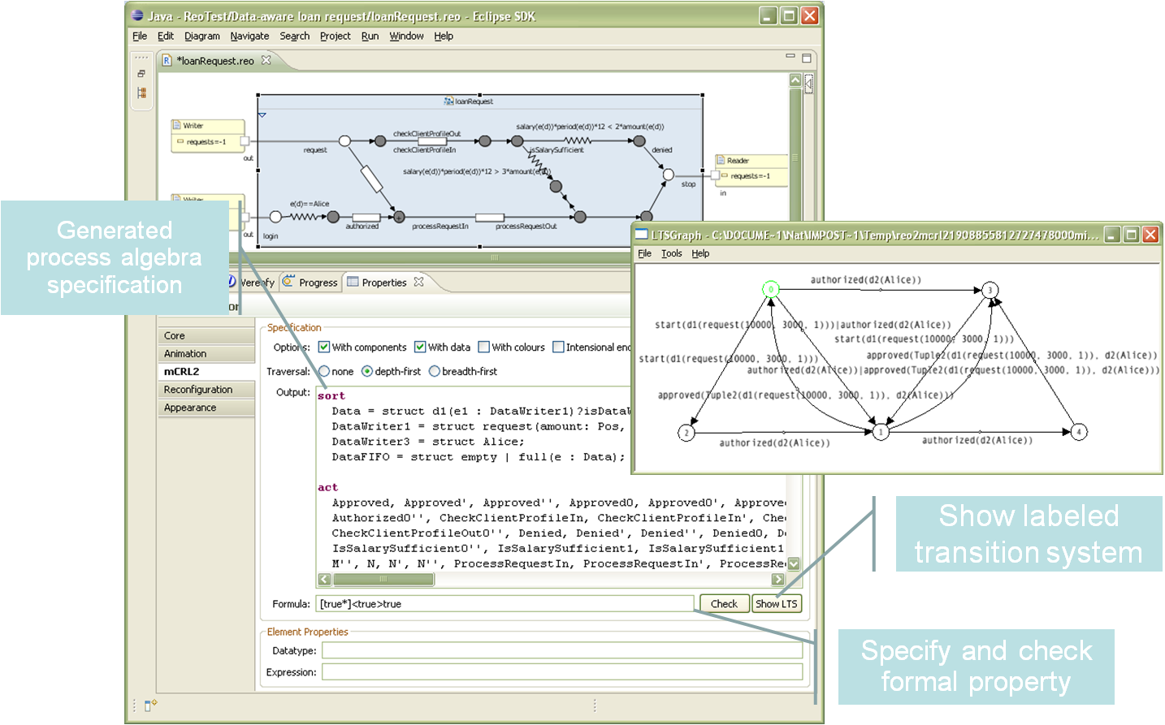
Data flow analysis with mCRL2

Slide 56
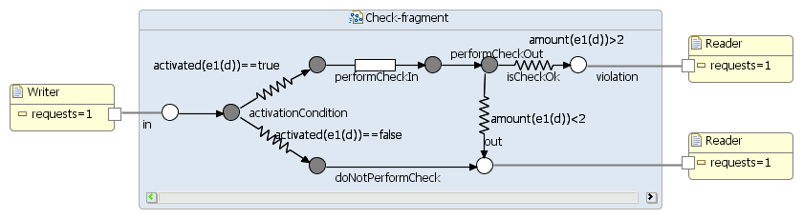
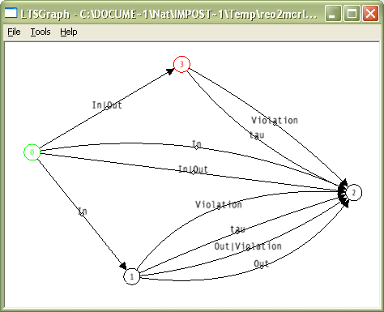
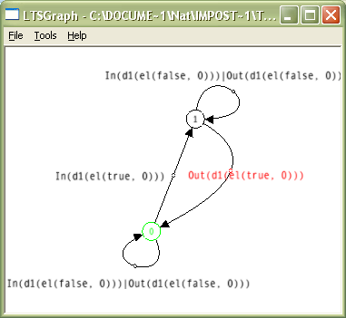
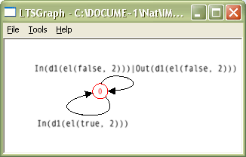
Data Dependent Control Flow
struct el(activated: Bool, amount: Nat)
(amount(d)<1)
(amount(d)==2)
No data

Slide 57
Process verification tools: summary
Vereofy:
  Advantages:
    Developed for Reo and Constraint Automata
    Visualization of counterexamples
  Disadvantages:
    No support for abstract data types
    Global domain for all components
    Primitive data constraint specification language (for filter channels)
mCRL2
  Advantages:
    Support abstract data types including lists and sets
    Allows the definition of functions
    Very rich property specification format (mu-calculus)
  Disadvantages:
    Hard to extract counterexamples
    For infinite domains model checker often does not terminate (problems with algorithms for formulae rewriting)

Slide 58
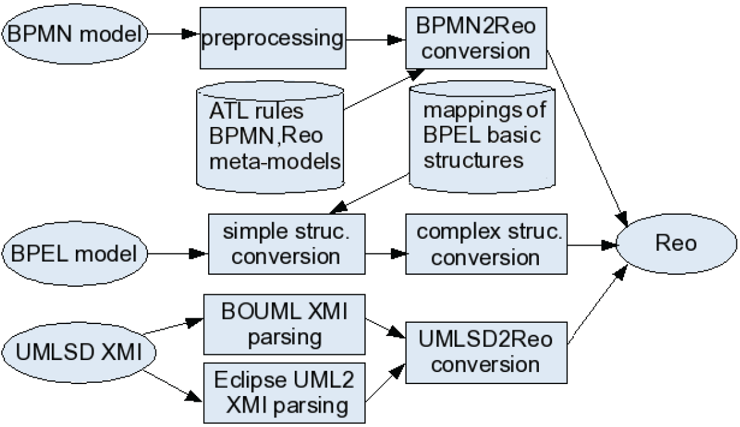
Architecture of ECT Converters

Slide 59
Conclusion
Reo is a simple, rich, versatile, and surprisingly expressive language for compositional construction of pure interaction protocols.
  Strict separation of computation and concurrency concerns.
  A model where interaction is (the only) first-class concept.
  Free combination of synchrony, exclusion, and asynchrony.
  Exogenous interaction /coordination.
  Direct composition of protocols:
    synchrony and exclusion propagate through composition.
  Verbatim reuse of protocols.
Model-driven development:
  from specification, analysis, and verification to executable.
http://reo.project.cwi.nl

