Slide 1
Notes on Human Robot Interaction
Michael Harrison

Slide 2
Human robot interaction
New perspective on old issues (new area for me!)
Inevitably software perspective, often treated from a hardware perspective
Some new issues for me: particularly, social interaction
Different kinds of interaction
Robot as tool
Robot as cyborg extension
Robot as avatar capable of being sociable partner
Inevitably mixed issues

Slide 3
References
A.M. Dearden, M.D. Harrison, and P.C. Wright. Allocation of function: scenarios, context and economics of effort. International Journal of Human-Computer Studies, 52(2):289–318, 2000.
M. A. Goodrich and A. C. Shultz. Human robot interaction: a survey. Foundations and Trends in Human-Computer Interaction, 1(3):203–275, 2007.
J. Guiochet and A. Vilchis. Safety analysis of a medical robot for tele-echography. In Proc. of the 2nd IARP IEEE/RAS joint workshop on Technical Challenge for Dependable Robots in Human Environments, Toulouse, France, pages 217–227, 2002.
Gary Klein, David D. Woods, Jeffrey M. Bradshaw, Robert R. Hoffman, and Paul J. Feltovich. Ten challenges for making automation a ”team player” in joint human-agent activity. IEEE Intelligent Systems, 19(6):91–95, 2004.
C. A. Miller. Human-computer etiquette. Communications of the ACM, 37(4):31–34, 2004.
B. Mutlu and J. Forlizzi. Robots in organizations: The role of workflow, social, and environmental factors in human-robot interaction. In Human-Robot Interaction (HRI), 2008 3rd ACM/IEEE International Conference on, pages 287–294, March 2008.
Raja Parasuraman and Christopher A. Miller. Trust and etiquette in high-criticality automated systems. Commun. ACM, 47(4):51–55, April 2004.
R. Parasuraman, T.B. Sheridan, and Christopher D. Wickens. A model for types and levels of human interaction with automation. Systems, Man and Cybernetics, Part A: Systems and Humans, IEEE Transactions on, 30(3):286–297, May 2000.
Pocock, S., Harrison, M., Wright, P. & Johnson, P. (2001). THEA: A technique for human error assessment early in design. In Hirose, M., editor, Human-Computer Interaction INTERACT'01 IFIP TC.13 International Conference on human computer interaction, pages 247-254. IOS Press.
Aaron Steinfeld, Terrence Fong, David Kaber, Michael Lewis, Jean Scholtz, Alan Schultz, and Michael Goodrich. Common metrics for human-robot interaction. In Pro- ceedings of the 1st ACM SIGCHI/SIGART Conference on Human-robot Interaction, HRI ’06, pages 33–40, New York, NY, USA, 2006. ACM.

Slide 4
Example (USAR)
Robot assisted urban search and rescue
Autonomy in confined spaces using its own sensors
Other situations require assistance because sensors do not provide enough information
Other situations, for example providing medication to trapped survivors, need supervision for legal reasons
Flexibility, dynamic shifts of control
Task domain complex

Slide 5
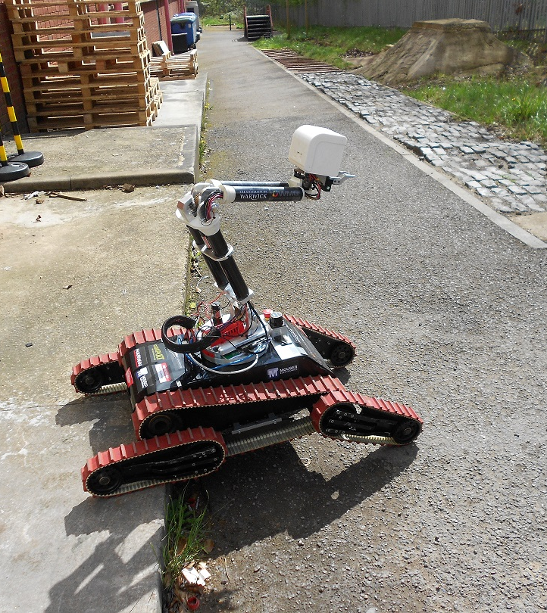
USAR robot
Processes and models:
How much autonomy when?
Dynamic shifts of control
Task domain complex
Human robot interaction
Often vision algorithms and multi-modal systems

Slide 6
Particular themes in the presentation
How the robot interacts with the human as it performs the task
What are the tasks?
Allocation of function?
Adaptation and mixed initiative?
How does the robot interact with the human?
Team player?
Etiquette?
Metrics, formalism and safety (and security)

Slide 7
Thinking of robots in terms of the functions they perform
Robots achieve goals
“delivering bed linen to ward 13”
To achieve goals they must achieve subgoals
“recognise intersection and take turning toward ward 13”
“recognise and avoid obstacle”

Slide 8
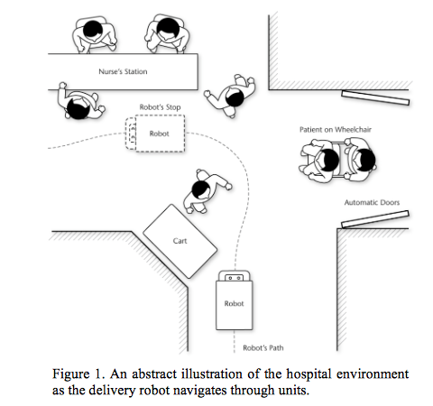
Delivery Robot

Slide 9
What does the robot do, what does the human do (RDHD)?
MABA-MABA lists (Fitts’ List)
10 level scale of automation (Sheridan and Verplank)
Degree of specificity required of the automation for making requests of the machine
Degree of specificity with which the machine communicates decision alternatives or action recommendations
Degree of human responsibility

Slide 10
(RDHD) Analysing stages of process
Further particularisation
Acquisition of information
Analysis of the information
Decision about actions to be taken based on the information
Systematic methods of function allocation
IDA-S (Dearden and others) incorporates process stages
Adds notion of role
Shapes function to role against criteria such as workload, performance, situation awareness

Slide 11
Delivery Robot

Slide 12
Dynamic allocation and adaptive automation
Particularly relevant in high performance situations
Changing level of automation dynamically, triggered by
Critical events
Measures of operator performance or physiology
Models of the operator
Hybrids that combine the above
Who initiates the adaptation: human or robot
Issues
Trust
Can help mitigate over-reliance, skill degradation, reduced situation awareness

Slide 13
How does a robot interact with its social context?
Study of hospital environment (Mutlu and Forlizzi)
Need for new roles to accommodate introduction of robots
Assessing effect of introduction crucial to success
Organisational factors affect how people respond

Slide 14
Social issues
Etiquette
Robot as team player
Specifics of interaction

Slide 15
Issues of Etiquette
Adapting Grice’s axioms (Miller)
Make it easy to override and correct errors
Robot should be capable of being informed that it has taken a wrong step
Robot should learn from mistakes
Should communicate clearly what it is doing and why
Should use multiple modalities and information channels redundantly
Should not assume every user is the same and be aware of what each user knows

Slide 16
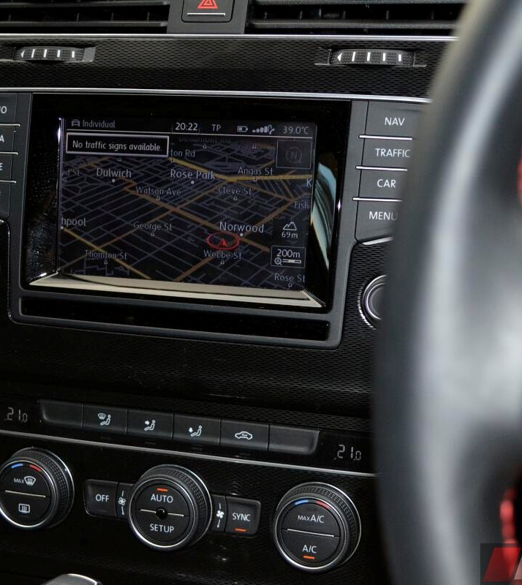
Simple stuff but …
System recalculating when you know the short cut
Next time it should take the short cut
Easy review of proposed route
Speech and text interchangeable
My wife and I see the system very differently

Slide 17
Robot as team player (cooperative robotics)
Opportunity afforded by adaptive automation and mixed initiative interaction
Robot as team player (Klein et al)
“basic compact” fulfil the requirements of a set of common grounded agreements
Rules? Agent must
fulfil the basic compact
Model other participants
Trust other agents
Agents must be directable
Make relevant signals of status
Be able to negotiate goals

Slide 18
Specifics of interaction
Robot as tool
some issues already covered
Robot as cyborg
Extension of self
Robot as avatar
For example
Redundancy of modes of interaction
Automatic determination of the addressee
Natural language understanding

Slide 19
Measures
Relating to navigation
Number of operator interventions, ratio of operator time to robot time
Management
Number of robots that can be controlled, delay between robot problem and intervention
Social persuasiveness, trust, engagement, compliance
Operator performance, situation awareness, workload, mental models

Slide 20
Safety
The hazard, human and environmental safety
Risks (likelihood and consequence)
Analysis
Evaluation
Control
Representing the robotic system
Tasks
Functions
Limits of the system

Slide 21
Risk Analysis
Identifying hazards based on deviations
Failure modes and effects and analysis
HAZOP
Fault Tree Analysis
Identifying mitigating factors
Defences / Barriers

Slide 22
Challenges for formalisation
Modelling tasks
Modelling sequences that achieve goals with possible deviations
Modelling common goals and common achievement
Modelling properties, such as etiquette properties for example

Slide 23
Combining formal techniques with safety analysis
Analyse human interactions for plausible interaction sequences
Use technique (such as THEA) that identifies causes based on cognitive plausibility
Assess likelihood, consequence and identify barriers or defences that mitigate risk
User-centred safety requirements

Slide 24
Conclusions
Clearly biased – substantial reviews elsewhere that focus on hardware issues
However interesting research challenges
Formulating and proving etiquette properties, for example

